Slide 1
Deep Learning
Generated for: RNNs, LSTMs, GRUs
Notes:
Welcome to the Deep Learning presentation covering multiple topics. Today we'll explore: RNNs, LSTMs, GRUs.

Slide 2
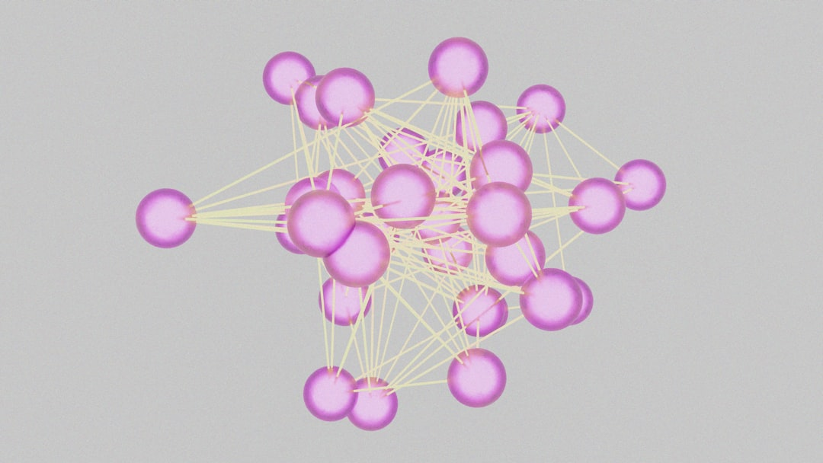
RNNs - Introduction
Recurrent Neural Networks process sequential data
RNNs use feedback connections to store information
Temporal relationships are key in RNNs
Applications include speech recognition systems
Natural Language Processing uses RNNs extensively
RNNs can learn from experience and adapt
Basic RNN architecture includes input and output
Hidden state captures sequential information
Backpropagation is used for training RNNs
Vanishing gradients are a common issue
Notes:
When introducing RNNs, emphasize their ability to process sequential data and their applications in speech recognition and NLP. Provide examples of how RNNs are used in real-world scenarios, such as language translation and text summarization. Ask students to consider the challenges of training RNNs, including vanishing gradients. Key takeaways include understanding the basic RNN architecture and its components, as well as the importance of temporal relationships in RNNs.

Slide 3
RNNs - Introduction
Recurrent Neural Networks process sequential data
RNNs have feedback connections for temporal relationships
Used for time series forecasting and natural language
RNNs learn patterns in sequential data streams
Can be trained on speech, text, or time series data
Simple RNNs have limitations due to vanishing gradients
Long Short-Term Memory networks mitigate this issue
Gated Recurrent Units are another variant of RNNs
RNNs are fundamental to deep learning architectures
Applications include language translation and speech recognition
Notes:
When introducing RNNs, emphasize their ability to handle sequential data and temporal relationships. Provide examples such as speech recognition, language translation, and time series forecasting. Explain the concept of feedback connections and how they allow RNNs to learn from previous inputs. Discuss the limitations of simple RNNs, such as vanishing gradients, and introduce variants like LSTMs and GRUs that address these issues. Ask students to consider how RNNs can be applied to real-world problems and what benefits they offer over traditional neural networks. Key takeaways should include the basics of RNN architecture, their applications, and the importance of variants like LSTMs and GRUs in overcoming limitations.

Slide 4
RNNs - Introduction
Recurrent Neural Networks process sequential data
RNNs have feedback connections for temporal relationships
Used for speech recognition and natural language processing
Capable of learning long-term dependencies in data
Basic RNNs suffer from vanishing gradient problem
Simple RNN architecture: input, hidden, output layers
Training RNNs involves backpropagation through time
RNNs are suitable for time series forecasting tasks
Common RNN applications include language modeling
RNNs can be used for machine translation tasks
Notes:
When introducing RNNs, explain that they are designed to handle sequential data and have feedback connections that allow them to capture temporal relationships. Provide examples of applications such as speech recognition, natural language processing, and time series forecasting. Discuss the basic RNN architecture and the challenges associated with training RNNs, including the vanishing gradient problem. Ask students to consider how RNNs can be used in real-world scenarios, such as language modeling and machine translation, and encourage them to think about the limitations and potential solutions for these models.

Slide 5
LSTMs - Introduction
Long Short-Term Memory networks handle sequential data
LSTMs are a type of Recurrent Neural Network
Used for natural language processing and time series
LSTMs learn long-term dependencies in data
Consist of memory cells and gates for control
Input gate controls new information addition
Output gate controls information output
Forget gate controls cell state reset
LSTMs are suitable for sequential data analysis
Examples include speech recognition and language translation
Notes:
When introducing LSTMs, emphasize their ability to handle sequential data and learn long-term dependencies. Explain the basic architecture, including memory cells and gates. Provide examples such as speech recognition and language translation to illustrate their application. Ask students to consider how LSTMs can be used in their own projects or research. Key takeaways include understanding the components of LSTMs and their suitability for sequential data analysis.

Slide 6
LSTMs - Introduction
Long Short-Term Memory networks introduced in 1997
Designed to handle vanishing gradient problem
Use memory cells to store information
Gates control information flow into cells
Input gate handles new information
Output gate generates final output
Forget gate resets cell state
LSTMs used in speech recognition systems
Also applied in language translation models
Effective in time series forecasting tasks
Notes:
When introducing LSTMs, explain the concept of vanishing gradients and how LSTMs address this issue. Provide examples of applications such as speech recognition and language translation. Ask students to consider how LSTMs can be used in their own projects, such as time series forecasting. Key takeaways include understanding the basic architecture of LSTMs and their ability to handle long-term dependencies.

Slide 7
LSTMs - Architecture and Key Components
LSTMs consist of memory cells and gates
Input gate controls new information flow
Output gate generates hidden state
Forget gate manages cell state
Cell state retains long-term information
Hidden state used for predictions
LSTMs learn long-term dependencies
Effective for sequential data processing
Used in language models and chatbots
Equation: h_t = o_t * tanh(c_t)
Notes:
When explaining LSTMs, emphasize the role of gates in controlling information flow. Use examples of language models and chatbots to illustrate sequential data processing. Ask students to consider how LSTMs learn long-term dependencies and how this is useful in real-world applications. Key takeaways include understanding the components of LSTMs and their ability to handle sequential data. Provide visual aids to help students visualize the architecture and its components.

Slide 8
GRUs - Introduction
Gated Recurrent Units simplify LSTMs with fewer gates
GRUs use update and reset gates for state management
Fewer parameters than LSTMs for similar tasks
Introduced in 2014 for sequence prediction tasks
GRUs are faster and more efficient than LSTMs
Used in natural language processing and speech recognition
GRUs handle vanishing gradients with gated mechanisms
Less complex architecture than traditional LSTMs
Suitable for real-time applications and embedded systems
Notes:
When explaining GRUs, start by comparing them to LSTMs, highlighting the reduction in gates and parameters. Discuss how this simplification affects performance and application in areas like NLP and speech recognition. Provide examples of sequence prediction tasks and ask students to consider how GRUs might be used in real-time systems. Key takeaways should include the advantages of GRUs over LSTMs in certain contexts and their suitability for embedded systems.

Slide 9
GRUs - Introduction
Gated Recurrent Units simplify LSTMs with fewer gates
GRUs use update and reset gates for hidden state
Introduced to reduce computational complexity
Useful for sequential data like speech or text
GRUs are faster to train than traditional LSTMs
Hidden state updated based on previous state
Reset gate controls forgetting previous state
Update gate controls new information addition
Wide applications in natural language processing
Notes:
When introducing GRUs, emphasize their role in simplifying LSTMs by reducing the number of gates, making them computationally less expensive and faster to train. Explain the function of the update and reset gates in managing the hidden state, and provide examples of sequential data where GRUs are particularly useful, such as speech recognition or text analysis. Ask students to consider how the reduction in gates affects the model's ability to learn from data. Key takeaways should include the architecture of GRUs, their advantages over LSTMs in certain scenarios, and their applications in deep learning tasks, especially those involving sequential data.

Slide 10
GRUs - Architecture
Gated Recurrent Units simplify LSTMs with fewer gates
GRUs use update and reset gates for hidden state
Update gate controls new information addition
Reset gate controls forgetting previous information
No separate memory cell like in LSTMs
Fewer parameters reduce computational overhead
GRUs are faster and more efficient than LSTMs
Suitable for sequences with limited context
Example: speech recognition, language modeling
Equation: h_t = (1 - z_t) * h_{t-1} + z_t * h_t'
Notes:
When discussing the architecture of GRUs, emphasize the simplification of LSTMs and the role of update and reset gates. Explain how these gates control the flow of information into the hidden state. Provide examples of applications where GRUs are particularly useful, such as speech recognition and language modeling. Ask students to consider the trade-offs between GRUs and LSTMs in terms of complexity and performance. Key takeaways include understanding the components of GRUs and their advantages in certain sequence modeling tasks.

